Slide 1
Presentation on
Pharmacology Drug Ontology

Slide 2
Goal of ontology
Pharmacology ontology will cover core systems such as Drug, Disease, Symptom. The drug includes Drug content, dose, drug type, a drug manufacturer.
In this ontology person suffering from disease have symptoms according to its age and gender. Moreover, diseases can be treated with different drugs same according to the age and gender as per the dose to be given. Each and Every drug has its rating which is the most important concept of this ontology, though it will give reviews about the drug for its further use. this ontology is convenient for the researchers and the biomedical students along with the new pharmacies to attend major information about the disease, symptoms and drug to be treated properly.

Slide 3
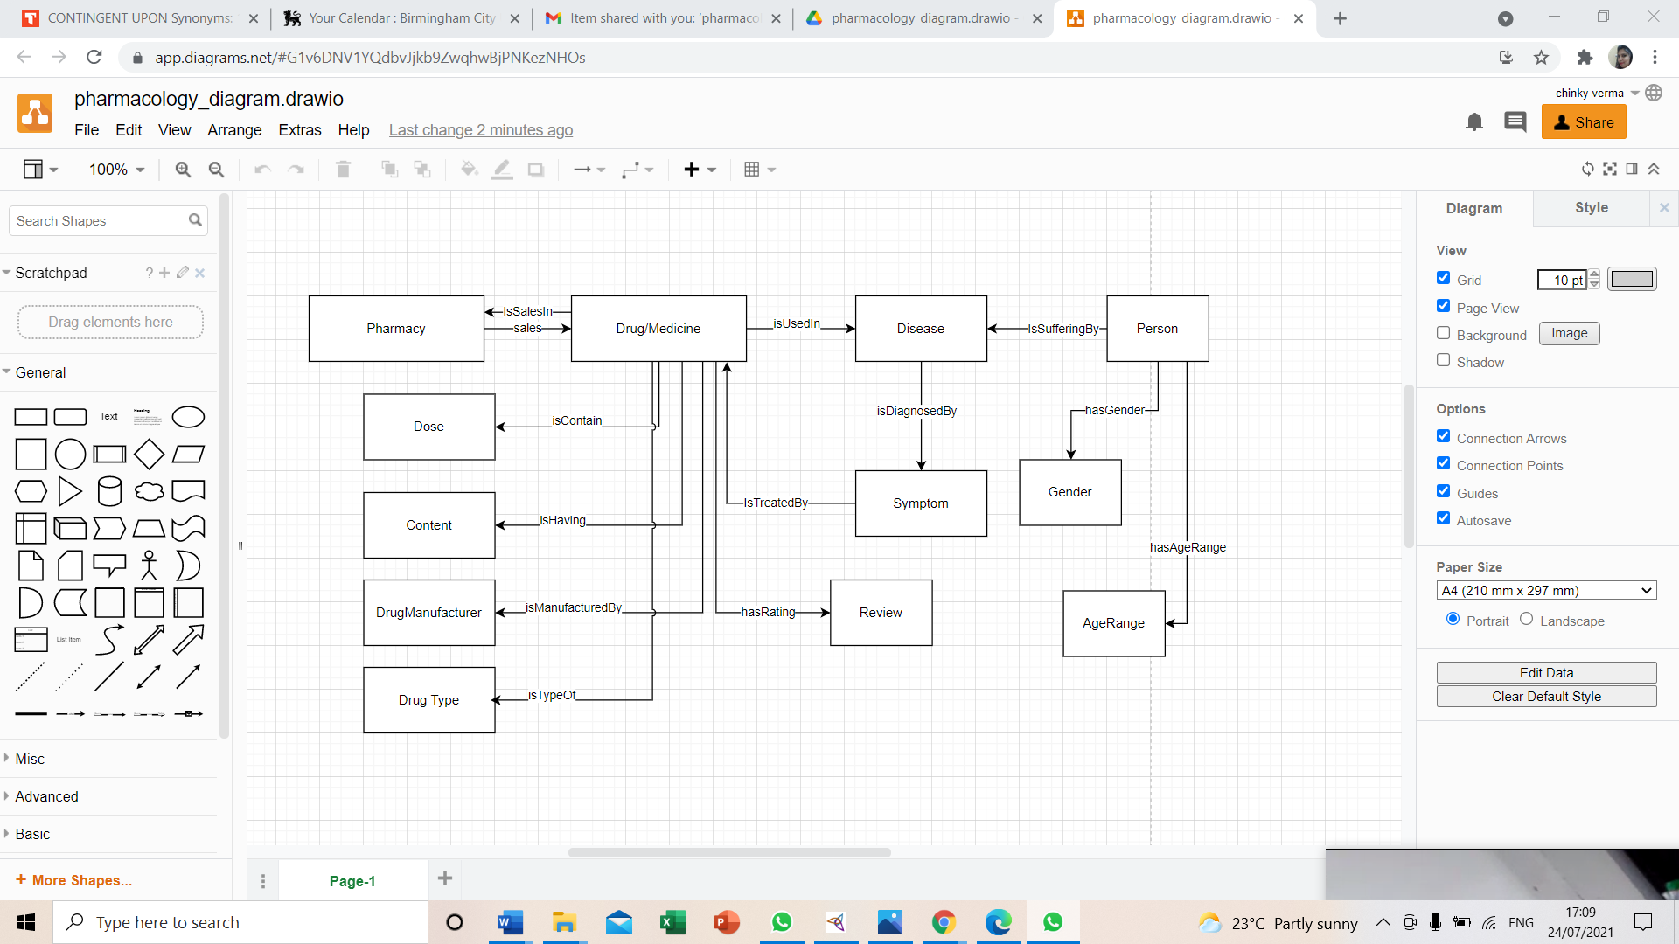

Slide 4
From entity-relationship diagram, Pharmacology ontology triples are following
Person is suffering from disease.
Disease is diagnosed by symptoms.
Drug or medicine is used in diseases.
Symptom is treated by Drug.
Drug or Medicine is containing dose.
Drug or Medicine is having Drug content.
Drug or Medicine is manufactured by drug manufacturer.
Drug or Medicine is type of drug types.
Drug has rating as Review.
Drug is sale in Pharmacy.

Slide 5
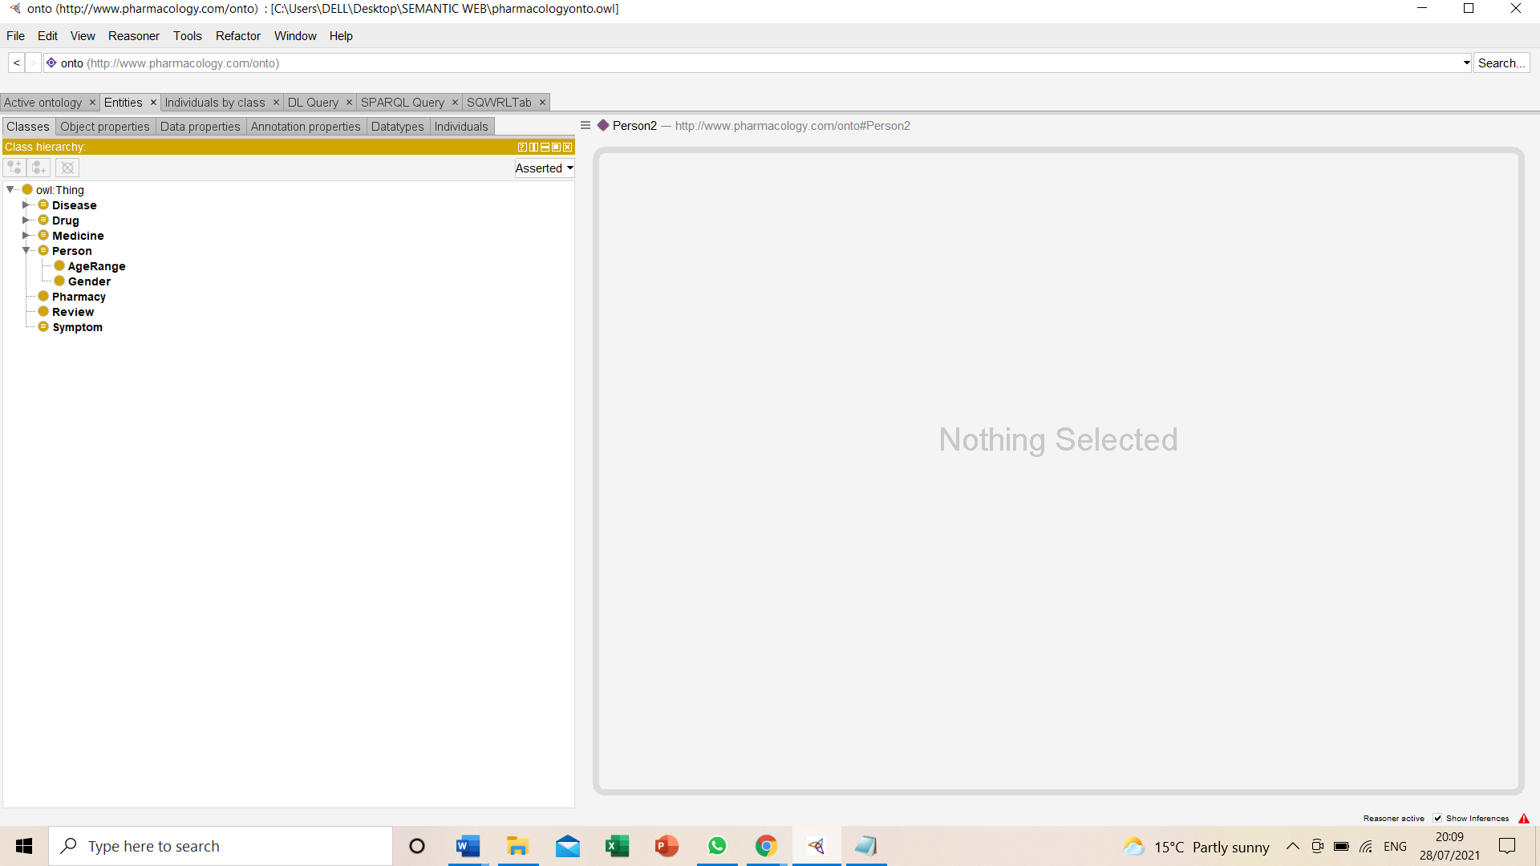
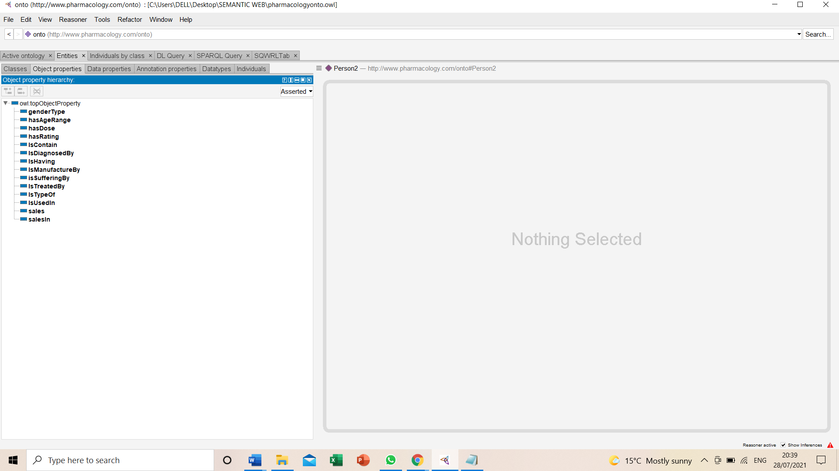
Classes and Object Properties

Slide 6
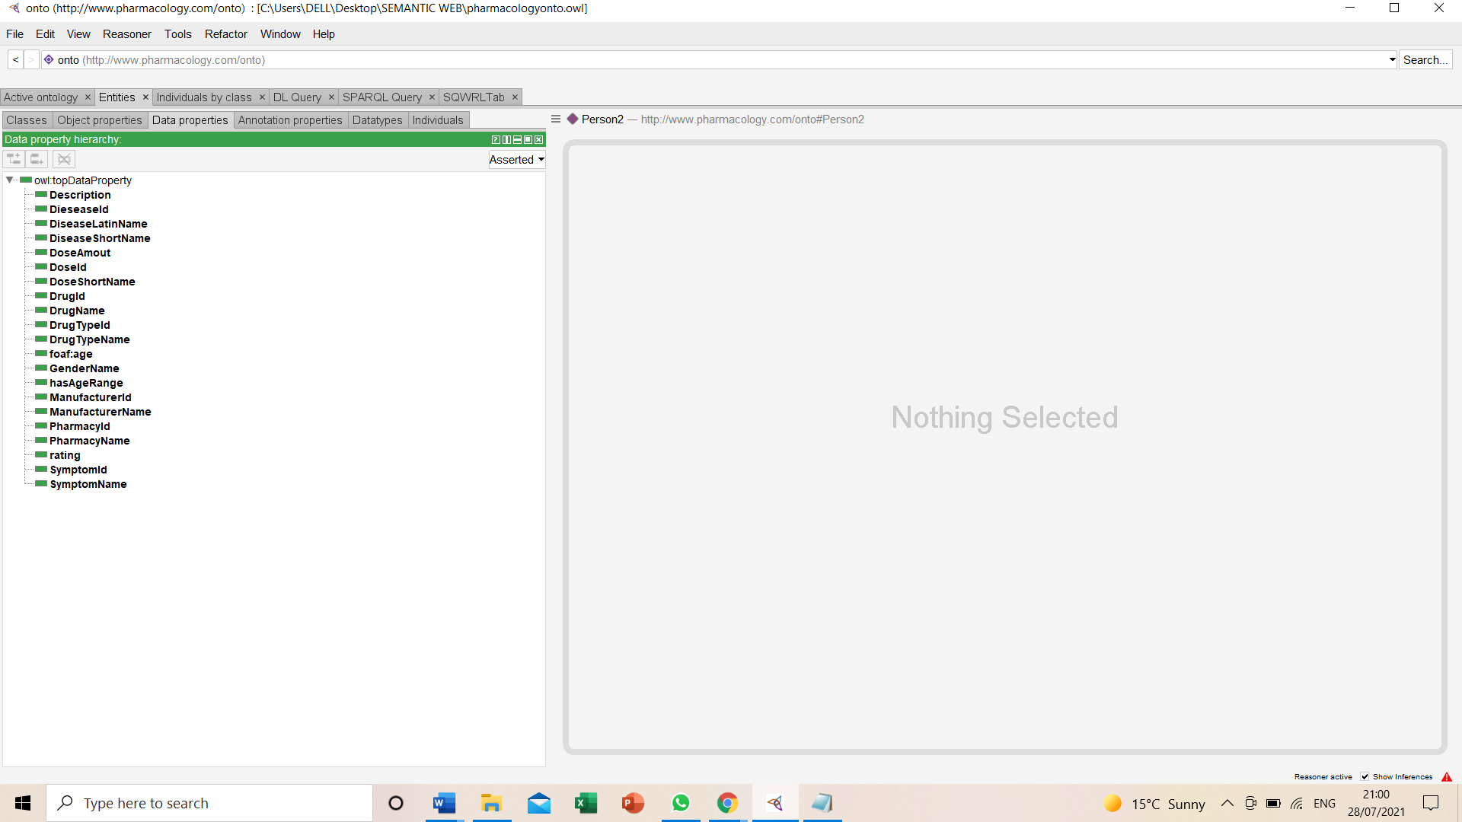
Data Property

Slide 7
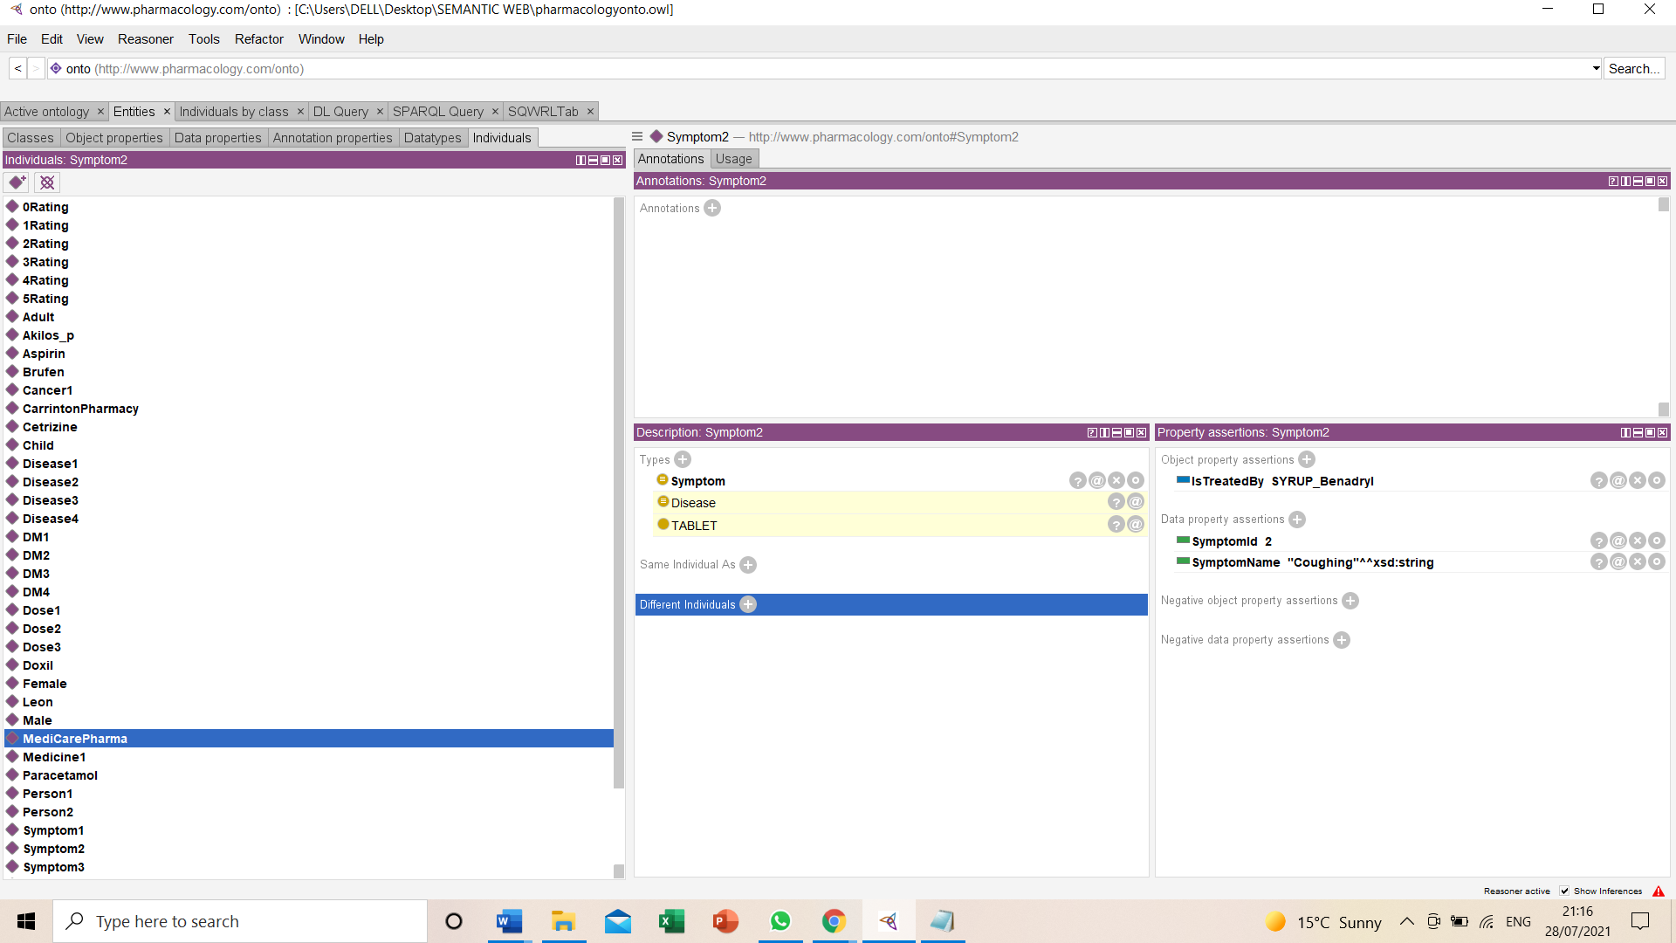
Individuals(Instance)

Slide 8
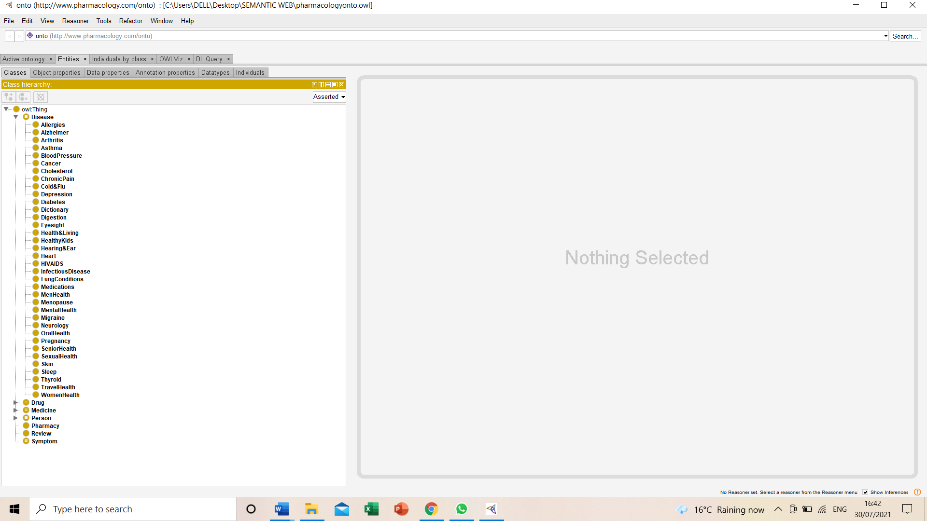
Pharmacology Drug Ontology Class diagram among other classes
Subclasses for disease

Slide 9
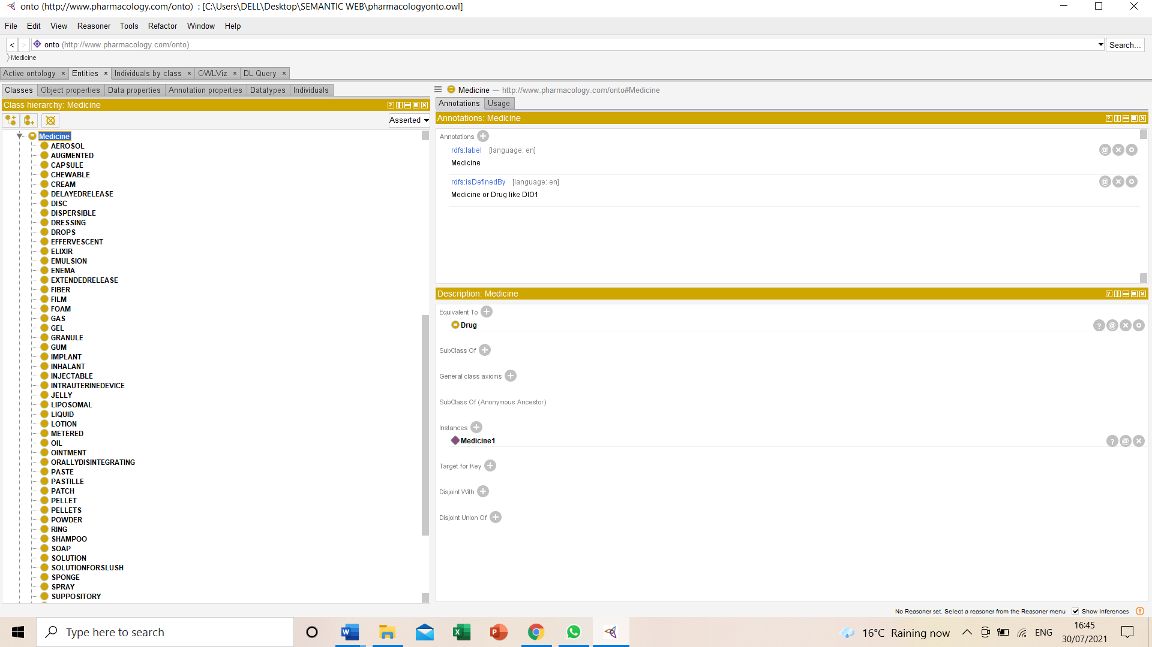
Medicine subclasses

Slide 10
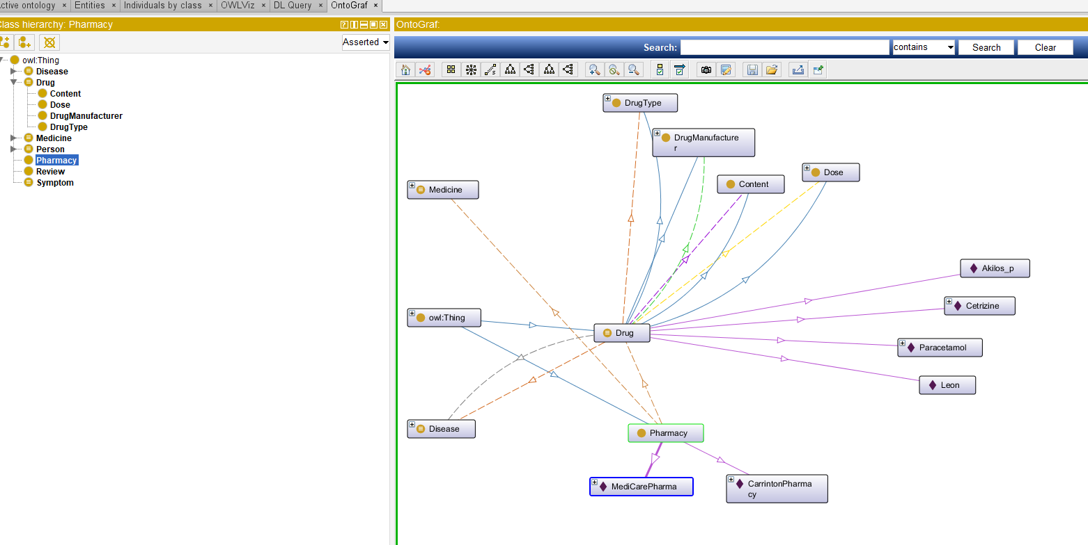
Subclasses of Drug

Slide 11
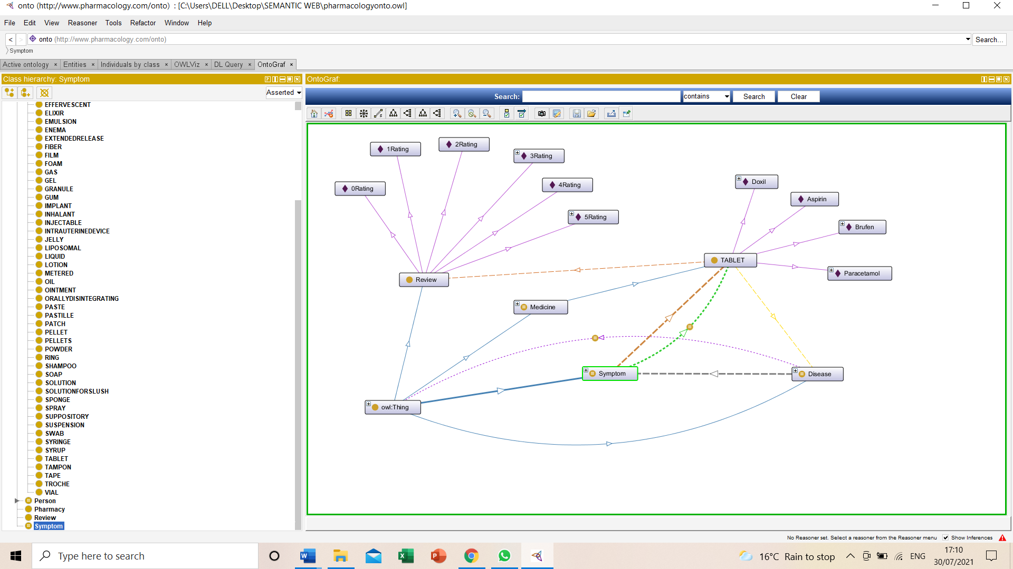

Slide 12
Competence Questions
SPARQL Questions : There are 6 SPARQL queries in pharmacology Drug ontology like
To display a Person detail like disease name, gender and age range?
To display about the Pharmacy selling the particular medicine?
To Search the disease according to the symptoms?
To Check Medicine detail in ontology using Ask query?
To display Dose short name in the ontology?
To display Drug Manufacturer company name?
To display Drug Manufacturer company name?SWRL Rules

Slide 13
Dl Queries in Pharamacology Drug ontology
To display disease which is diagnosed by some symptoms?
To display Pharmacy sale of some medicine ?
To display information about the person who has minimum one symptom and can be treated by medicines?
To display the reviews about the drugs in Dl query ?
To display disease short name?
To display the gender type of the person ?

Slide 14
INTELLIGENCE OF ONTOLOGY
SWRL Functional Rules
To display Which Pharmacy sales the particular Medicine?
To display the details about Symptom which will be treated by which Medicine?
To display disease which is related to Eye Deficiency?
To display the disease which has Symptoms for Dry Skin?

Slide 15
Conclusion And Future work
This study describes the drugs in detail with its content, type, manufacturer, dose etc which is further sold in the pharmacy. Evaluation of this ontology also reveals the information about the reviews which plays an inevitable role in this pharmacology drug methodology as it gives rating to the drugs which is more convenient for the future use.
This ontology indicates the classification criteria for active pharmaceutical ingredients and can be used by international biomedical students, researches and pharmaceutical organisations. Further, having immense medical data cane give more effectiveness to the ontology. More homeopathic and allopathic drug details can be added this ontology to enhance this topic widely.
Pharmacology drug ontology is conveniently used in numerous areas especially for the biomedical space

